Slide 1

Finding the best spot for opening a new restaurant in Calgary
IBM Data Science Capstone Project,, May, 2020

Slide 2
Business Challenge
Competitive industry
Success dependant on location
Right type of restaurant for each neighborhood

Slide 3
Data Sources
Calgary neighborhood data from Wikipedia
Calgary neighborhood venue data from Foursquare

Slide 4
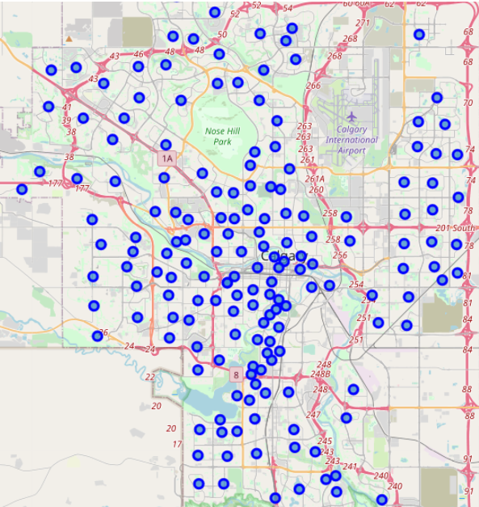

Calgary Neighborhoods

Slide 5
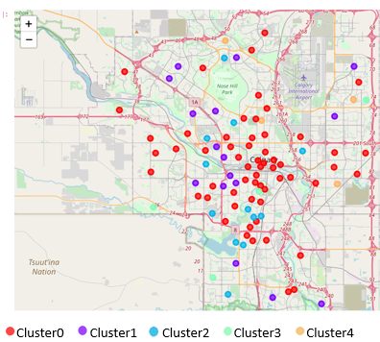
Clustering based on restaurant type
Cluster0: biggest cluster, diverse with the highest eastern restaurant count
Cluster1: Mostly pizza place, wing joint and Italian restaurant
Cluster2: Mostly Pubs, wing joints, falafel restaurant
Cluster3: Indian restaurant neighborhood
Cluster4: Mostly fast food, wing joints, falafel restaurant

Slide 6
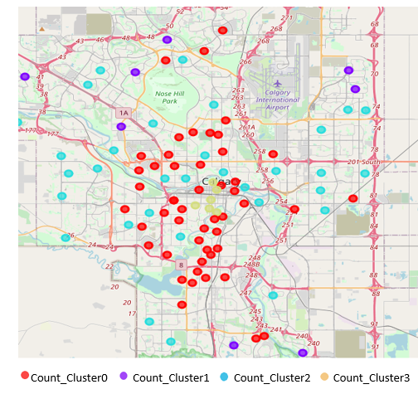
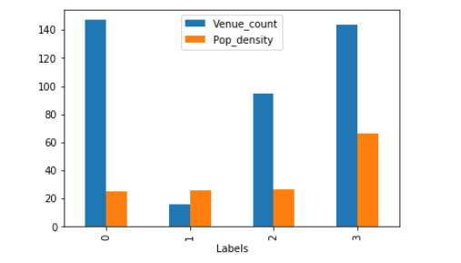
Clustering based on venue count and population density

Slide 7
Conclusion
Cluster1 and 2 are saturated with pizza places and pubs respectively
Cluster3 can be defined as Indian food cluster
Count_Cluster0, the inner-city area, high venue count per population density. Very competitive
Count_Cluster1, suburban area, very low venue count per population density less competition
Count_Cluster2, medium venue count per population density. moderately competitive
Count_Cluster3, downtown area, highest population density with 140 venues in a very compact area

